Slide 1
Network Layer: Link Layer; Course Summary
Qiao Xiang, Congming Gao, Qiang Su
https://sngroup.org.cn/courses/cnns-xmuf25/index.shtml
12/4/2025
This deck of slides are heavily based on CPSC 433/533 at Yale University, by courtesy of Dr. Y. Richard Yang.

Slide 2
Recap: IP Addressing Scheme: Requirements
Uniqueness: We need an address to uniquely identify each destination
Aggregability : Routing scalability needs flexibility in aggregation of destination addresses
we want to aggregate as a large set of destinations as possible in BGP announcements
Current: the unit of routing in the Internet is a classless interdomain routing (CIDR) address

Slide 3
Recap: Network Forwarding: Putting it Together
Forwarding is also called the fast path (upon receiving each packet)
Slow path: not per packet
Get IP address (DHCP, or static)
Setup/compute routing table

Slide 4
Recap: Putting it Together: Example 2 (Different Networks): A-> E
forwarding table in A
misc
fields
223.1.1.1
223.1.2.3
data
Dest. Net. next router Nhops
Setting: Host A network layer receives a packet above.
Action:
Host A looks up destination in routing table
Find next hop should be 223.1.1.4
Hand datagram to link layer to send inside a link-layer frame
223.1.1/24 1
223.1.2/24 223.1.1.4 2
223.1.3/24 223.1.1.4 2
0.0.0.0/0 223.1.1.4 -
A
To Internet
223.1.1.1
223.1.4.1
223.1.2.1
223.1.1.2
223.1.1.4
223.1.2.9
frame dst, src addr
datagram source,
dest address
B
C
223.1.2.3
223.1.1.3
223.1.3.27
E
C’s MAC
addr
A’s MAC
addr
A’s IP
addr
E’s IP
addr
IP payload
223.1.3.1
223.1.3.2
datagram
frame

Slide 5
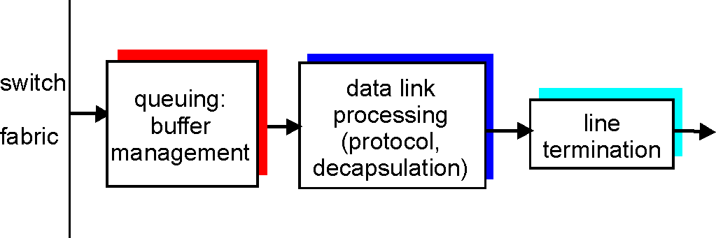
Recap: Look Inside a Router: Output Port
Buffering required when datagrams arrive from fabric faster than the transmission rate
Queueing (delay) and loss due to output port buffer overflow !
Scheduling and queue/buffer management choose among queued datagrams for transmission

Slide 6
Recap: Putting it Together: Example 2 (Different Networks): A-> E
forwarding table in router
misc
fields
223.1.1.1
223.1.2.3
data
Dest. Net router Nhops interface
Setting: Packet above arrives at Router C’s network layer.
Action:
Router C conducts standard router actions
Assume packet correct, find next hop should be 223.1.2.9
Hand datagram to link layer to send inside a link-layer frame
223.1.1/24 - 1 223.1.1.4
223.1.2/24 - 1 223.1.2.9
223.1.3/24 - 1 223.1.3.27
0.0.0.0/0 - - 223.1.4.1
A
To Internet
223.1.1.1
223.1.4.1
223.1.2.1
223.1.1.2
223.1.1.4
223.1.2.9
frame dst, src addr
datagram source,
dest address
B
C
223.1.2.3
223.1.1.3
223.1.3.27
E
E’s MAC
addr
C’s MAC
addr
A’s IP
addr
E’s IP
addr
IP payload
223.1.3.1
223.1.3.2
datagram
frame
datagram arrives at 223.1.2.3!! (hooray!)

Slide 7
Outline
Admin and recap
Network layer
Link layer
Overview
Media access
Link layer forwarding

Slide 8
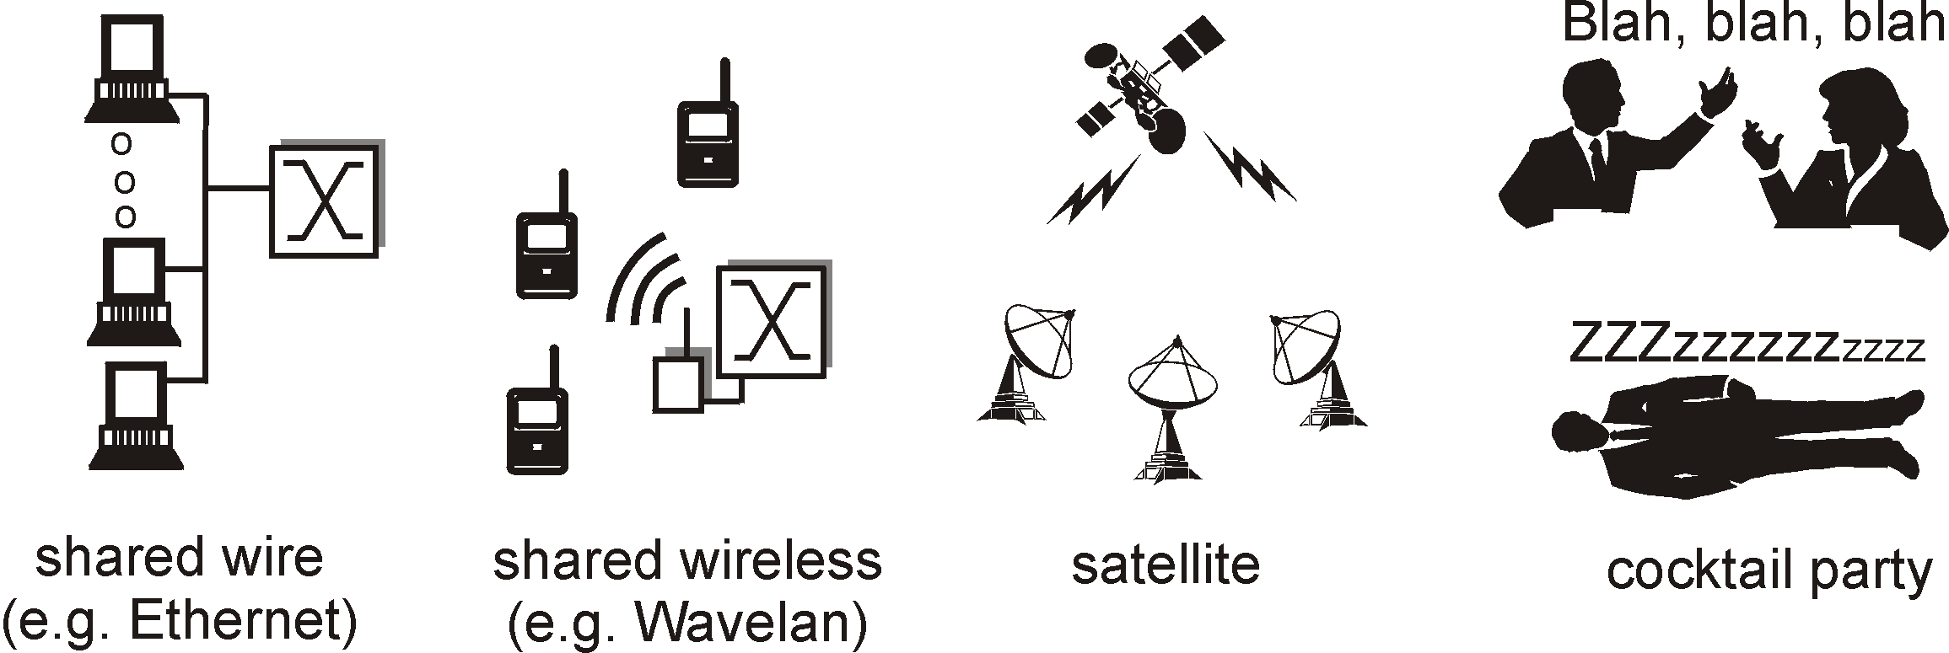
Multiple Access Links and Protocols
Many link layers use broadcast (shared wire or medium)
traditional Ethernet; Cable networks
802.11 wireless LAN; cellular networks
satellite
Problem: if two or more simultaneous transmissions, due to interference, only one node can send successfully at a time (see CDMA later for an exception)

Slide 9
Multiple Access Protocol
Protocol that determines how nodes share channel, i.e., determines when nodes can transmit
Communication about channel sharing must use channel itself !
Discussion: properties of an ideal multiple access protocol.

Slide 10
Ideal Mulitple Access Protocol
Broadcast channel of rate R bps
Efficiency: when only one node wants to transmit, it can send at full rate R
Rate allocation:
simple fairness: when N nodes want to transmit, each can send at average rate R/N
we may need more complex rate control
Decentralized:
no special node to coordinate transmissions
no synchronization of clocks
Simple

Slide 11
MAC Protocols
Goals
efficient, fair, decentralized, simple
Three broad classes:
non-partitioning
random access
allow collisions
“taking-turns”
a token coordinates shared access to avoid collisions
channel partitioning
divide channel into smaller “pieces” (time slot, frequency, code)

Slide 12
Focus: Random Access Protocols
Examples of random access MAC protocols:
slotted ALOHA and pure ALOHA
CSMA and CSMA/CD, CSMA/CA
Ethernet, WiFi 802.11
Key design points:
when to access channel?
how to detect collisions?
how to recover from collisions?

Slide 13

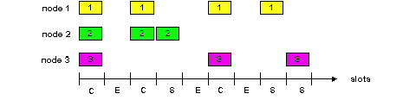
Slotted Aloha [Norm Abramson]
Time is divided into equal size slots (= pkt trans. time)
Node with new arriving pkt: transmit at beginning of next slot
If collision: retransmit pkt in future slots with probability p, until successful.
Success (S), Collision (C), Empty (E) slots

Slide 14
Slotted Aloha in Real Life
call setup in GSM
MS
BTS
Notations:
Broadcast control channel (BCCH): from base station, announces cell identifier, synchronization
Random access channel (RACH): MSs for initial access, slotted Aloha
access grant channel (AGCH): BTS informs an MS its allocation
standalone dedicated control channel (SDCCH): signaling and short message between MS and an MS
Traffic channels (TCH)
RACH (request signaling channel)
AGCH (assign signaling channel)
SDCCH (request call setup)
SDCCH message exchange
SDCCH (assign TCH)
Communication

Slide 15
Slotted Aloha Efficiency
Q: What is the fraction of successful slots?
suppose n stations have packets to send
suppose each transmits in a slot with probability p
- prob. of succ. by a specific node: p (1-p)^{(n-1)}
- prob. of succ. by any one of the N nodes
S(p) = n * Prob (only one transmits)
= n p (1-p)^{(n-1)}

Slide 16
Goodput vs. Offered Load for Slotted Aloha
S = throughput = “goodput”
(success rate)
Slotted Aloha
0.5
1.0
1.5
2.0
G = offered load = np
when p n < 1, as p (or n) increases
probability of empty slots reduces
probability of collision is still low, thus goodput increases
when p n > 1, as p (or n) increases,
probability of empty slots does not reduce much, but
probability of collision increases, thus goodput decreases
goodput is optimal when p n = 1, n -> infinite, S -> 1/e (~37%)

Slide 17
Dynamics of (Slotted) Aloha
Slotted Aloha has maximum throughput when np = 1
Implies we need to adjust p as the number of backlog stations varies.
Early design question: what is the effect if we do not change p-–use a fixed p
Assume we have a total of m stations (the machines on a LAN):
n of them are currently backlogged, each tries with a (fixed) probability p
the remaining m-n stations are not backlogged. They may start to generate packets with a probability p_{a}, where p_{a} is much smaller than p

Slide 18
Model
n backlogged
each transmits with prob. p
m-n: unbacklogged
each transmits with prob. p_{a}

Slide 19
Dynamics of Aloha: Effects of Fixed Probability
- assume a total of
m stations
p_{a} << p
success rate is the departure rate, the rate the backlog is reducing
desirable stable point
successful transmission rate at offered load np + (m-n)p_{a}
dep.
and
arrival
rate
of
backlogged
stations
new arrival rate: (m-n) p_{a}
undesirable stable point
0
offered load = 1
m
n: number of backlogged
stations
Lesson: if we fix p, but n varies, we may have an undesirable stable point

Slide 20
Summary of Problems of Aloha Protocols
Problems
slotted Aloha has better efficiency than pure Aloha but clock synchronization is hard to achieve
Aloha protocols have low efficiency due to collision or empty slots
when offered load is optimal (p = 1/N), the goodput is only about 37%
when the offered load is not optimal, the goodput is even lower
undesirable steady state at a fixed transmission rate, when the number of backlogged stations varies
Ethernet design: address the problems:
optimal transmission rate
Notes:
Slotted aloha Implied requirement: clock synchronization
Pure aloha, no sync, but even lower performance, ½ of slotted aloha, in textbook

Slide 21
The Basic MAC Mechanisms of Ethernet
get a packet from upper layer;
K := 0; n := 0; // K: control wait time; n: no. of collisions
repeat:
wait for K * 512 bit-time;
while (network busy) wait;
wait for 96 bit-time after detecting no signal;
transmit and detect collision;
if detect collision
stop and transmit a 48-bit jam signal;
n ++;
m:= min(n, 10), where n is the number of collisions
choose K randomly from {0, 1, 2, …, 2^{m}-1}.
if n < 16 goto repeat
else give up

Slide 22
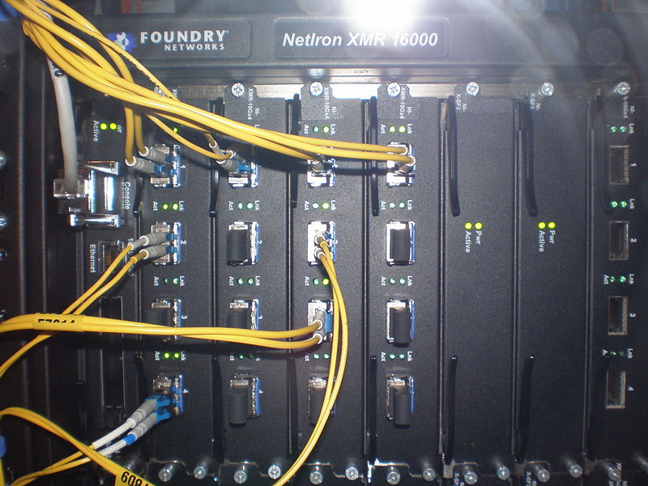
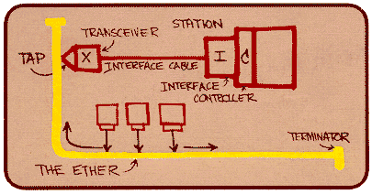
Ethernet
“Dominant” LAN technology:
First widely used LAN technology
Kept up with speed race: 10 Mbps, 100 Mbps, 1 Gbps, 10 Gbps
Metcalfe’s Ethernet
sketch

Slide 23
Outline
Admin and recap
Link layer
Ethernet switch

Slide 24
Ethernet Switch
link-layer device: takes an active role
store, forward Ethernet frames
examine incoming frame’s MAC address, selectively forward frame to one-or-more outgoing links when frame is to be forwarded on segment, uses CSMA/CD to access segment
transparent
hosts are unaware of presence of switches
plug-and-play, self-learning
switches do not need to be configured

Slide 25



Switch: Multiple Simultaneous Transmissions
hosts have dedicated, direct connection to switch
switches buffer packets
Ethernet protocol used on each incoming link, but no collisions; full duplex
each link is its own collision domain
switching: A-to-A’ and B-to-B’ can transmit simultaneously, without collisions
A
C’
B
6
1
2
5
4
3
B’
C
A’
switch with six interfaces
(1,2,3,4,5,6)

Slide 26
Switch Forwarding Table
Q: how does switch know A’ reachable via interface 4, B’ reachable via interface 5?
A
C’
B
6
1
2
A: each switch has a switch table, each entry:
(MAC address of host, interface to reach host, time stamp)
looks like a routing table!
5
4
3
B’
C
A’
switch with six interfaces
(1,2,3,4,5,6)
Q: how are entries created, maintained in switch table?
something like a routing protocol?

Slide 27
Switch: Self-Learning
Source: A
Dest: A’
switch learns which hosts can be reached through which interfaces
when frame received, switch “learns” location of sender: incoming LAN segment
records sender/location pair in switch table
A
A A’
C’
B
6
1
2
5
4
3
B’
C
A’
MAC addr interface TTL
A
1
60
Switch table
(initially empty)

Slide 28
Switch: Frame Filtering /Forwarding
when frame received at switch:
1. record incoming link, MAC address of sending host
2. index switch table using MAC destination address
3. if entry found for destination then {
if destination on segment from which frame arrived then drop frame
else forward frame on interface indicated by entry
}
else flood /* forward on all interfaces except arriving
interface */

Slide 29
Self-Learning, Forwarding: Example
Source: A
Dest: A’
A
A A’
frame destination, A’, location unknown:
flood
C’
B
destination A location known:
6
1
2
A A’
A A’
A A’
A A’
selectively send
on just one link
A A’
5
4
3
B’
C
A’ A
A’
MAC addr interface TTL
A
1
60
switch table
(initially empty)
A’
4
60

Slide 30

Interconnecting Switches
self-learning switches can be connected together:
S₄
S₁
S₃
A
S₂
F
I
B
C
D
E
G
H
Q: sending from A to G - how does S₁ know to forward frame destined to G via S₄ and S₃?
A: self learning! (works exactly the same as in single-switch case!)
Notes:
Network needs to be a tree

Slide 31
Self-Learning Multi-switch Example
Suppose C sends frame to I, I responds to C
S₄
S₁
S₃
A
S₂
F
I
B
C
D
E
G
H
Offline Exercise: show switch tables and packet forwarding in S₁, S₂, S₃, S₄

Slide 32
Institutional Network
mail server
to external
network
router
web server
IP subnet

Slide 33
Switches vs. Routers
application
transport
network
link
physical
both are store-and-forward:
routers: network-layer devices (examine network-layer headers)
switches: link-layer devices (examine link-layer headers)
both have forwarding tables:
routers: compute tables using routing algorithms, IP addresses
switches: learn forwarding table using flooding, learning, MAC addresses
datagram
frame
link
physical
frame
switch
network
link
physical
datagram
frame
application
transport
network
link
physical

Slide 34
Outline
Course Summary

Slide 35
Synthesis: A Day in the Life of a Web Request
journey down protocol stack complete!
application, transport, network, link
putting-it-all-together: synthesis!
goal: identify, review, understand protocols (at all layers) involved in seemingly simple scenario: requesting www page
scenario: student attaches laptop to campus network, requests/receives www.tencent.com

Slide 36




A Day in the Life: Scenario
browser
DNS server
Comcast network
68.80.0.0/13
school network
68.80.2.0/24
web page
web server
Tencent’s network
64.233.160.0/19
64.233.169.105

Slide 37
A Day in the Life… Connecting to the Internet
DHCP
DHCP
UDP
IP
Eth
Phy
connecting laptop needs to get its own IP address, addr of first-hop router, addr of DNS server: use DHCP
DHCP
DHCP
DHCP
DHCP
DHCP request encapsulated in UDP, encapsulated in IP, encapsulated in 802.3 Ethernet
DHCP
DHCP
UDP
IP
Eth
Phy
DHCP
DHCP
DHCP
DHCP
router
(runs DHCP)
Ethernet frame broadcast (dest: FFFFFFFFFFFF) on LAN, received at router running DHCP server
Ethernet demuxed to IP demuxed, UDP demuxed to DHCP

Slide 38
A Day in the Life… Connecting to the Internet
DHCP
DHCP
UDP
IP
Eth
Phy
DHCP server formulates DHCP ACK containing client’s IP address, IP address of first-hop router for client, name & IP address of DNS server
DHCP
DHCP
DHCP
encapsulation at DHCP server, frame forwarded (switch learning) through LAN, demultiplexing at client
DHCP
DHCP
UDP
IP
Eth
Phy
DHCP
DHCP
DHCP
router
(runs DHCP)
DHCP
DHCP client receives DHCP ACK reply
Client now has IP address, knows name & addr of DNS
server, IP address of its first-hop router

Slide 39
A Day in the life… ARP (before DNS, before HTTP)
DNS
DNS
UDP
IP
Eth
Phy
before sending HTTP request, need IP address of www.tencent.com: DNS
DNS
DNS
ARP
ARP query
DNS query created, encapsulated in UDP, encapsulated in IP, encapsulated in Eth. To send frame to router, need MAC address of router interface: ARP
ARP
ARP reply
Eth
Phy
router
(runs DHCP)
ARP query broadcast, received by router, which replies with ARP reply giving MAC address of router interface
client now knows MAC address of first hop router, so can now send frame containing DNS query

Slide 40
A Day in the Life… Using DNS
DNS
UDP
IP
Eth
Phy
DNS
DNS server
DNS
UDP
IP
Eth
Phy
DNS
DNS
DNS
DNS
DNS
DNS
DNS
DNS
Comcast network
68.80.0.0/13
IP datagram forwarded from campus network into Comcast network, routed (tables created by RIP, OSPF, IS-IS and/or BGP routing protocols) to DNS server
router
(runs DHCP)
IP datagram containing DNS query forwarded via LAN switch from client to 1st hop router
demuxed to DNS server
DNS server replies to client with IP address of www.tencent.com

Slide 41
A Day in the Life…TCP Connection Carrying HTTP
HTTP
HTTP
TCP
IP
Eth
Phy
SYNACK
SYN
SYNACK
SYN
SYNACK
SYN
SYN
to send HTTP request, client first opens TCP socket to web server
router
(runs DHCP)
TCP
IP
Eth
Phy
TCP SYN segment (step 1 in 3-way handshake) inter-domain routed to web server
SYNACK
SYN
SYNACK
SYN
SYNACK
SYNACK
SYN
web server responds with TCP SYNACK (step 2 in 3-way handshake)
web server
64.233.169.105
TCP connection established!

Slide 42
A Day in the Life… HTTP Request/Reply
HTTP
HTTP
TCP
IP
Eth
Phy
web page finally (!!!) displayed
HTTP
HTTP
HTTP
HTTP
HTTP
HTTP
HTTP
HTTP
HTTP request sent into TCP socket
router
(runs DHCP)
IP datagram containing HTTP request routed to www.tencent.com
HTTP
HTTP
TCP
IP
Eth
Phy
HTTP
HTTP
HTTP
web server responds with HTTP reply (containing web page)
HTTP
web server
64.233.169.105
IP datagram containing HTTP reply routed back to client

Slide 43
Course Topics Summary
The Internet is a general-purpose, large-scale, distributed computer network
Major design features/principles
packet switching/statistical multiplexing
time-reversibility, queueing theory and performance analysis
layered architecture, hour-glass architecture
end-to-end principle
decentralized (social-technocal) architecture
e.g., DNS (hierarchy delegation), interdomain routing (peer-to-peer)
resource allocation framework
axiom-based design (NBS); optimization decomposition through duality
adaptive control
e.g., sliding window self clocking, AIMD adaptation, Ethernet exp backoff
tradeoff between theoretical impossibility and practice

Slide 44

First-Day Class: What is a Network Protocol?
A network protocol defines the format and the order of messages exchanged between two or more communicating entities, as well as the actions taken on the transmission and/or receipt of a message or other events.
Protocols that we have touched on?

Slide 45
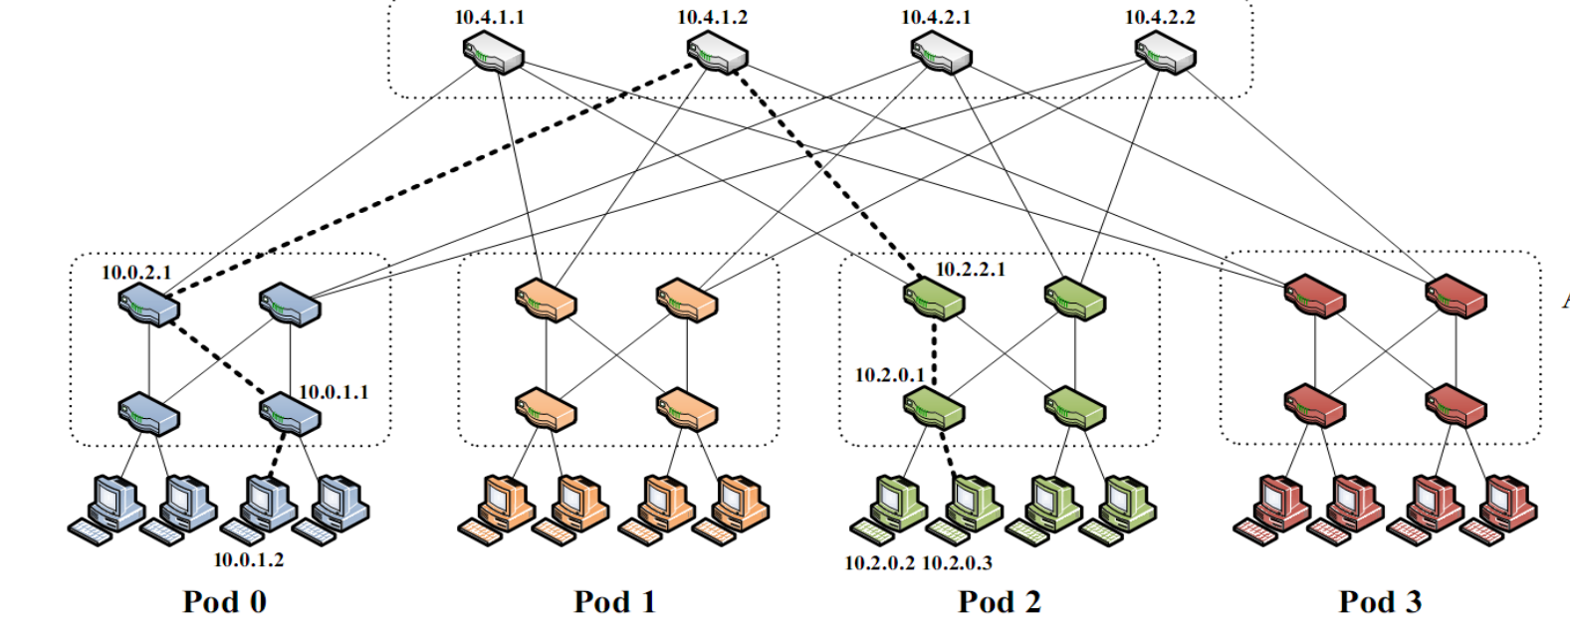
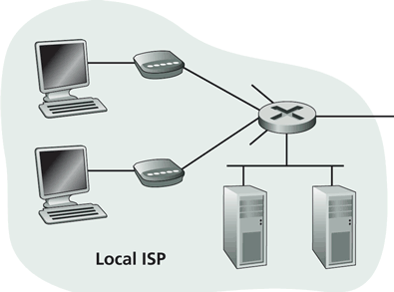
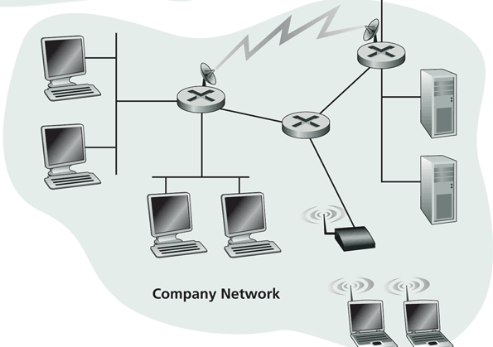
First-Day Class: Internet Physical Infrastructure
Residential access
Cable, Fiber, DSL, Wireless
ISP
Backbone ISP
ISP
The Internet is a network of networks
Each individually administrated network is called an Autonomous System (AS)
data center
Campus access, e.g.,
Ethernet
Wireless
https://www.google.com/loon/how/

Slide 46
First-Day Class: General Complexity
Complexity in highly organized systems arises primarily from design strategies intended to create robustness to uncertainty in their environments and component parts.
Scalability is robustness to changes to the size and complexity of a system as a whole.
Evolvability is robustness of lineages to large changes on various (usually long) time scales.
Reliability is robustness to component failures.
Efficiency is robustness to resource scarcity.
Modularity is robustness to component rearrangements.
David Meyer

Slide 47
First-Day Class: Evolution
Driven by Technology, Infrastructure, Policy, Applications (usage), and Understanding:
technology
e.g., wireless/optical communication technologies and device miniaturization (sensors)
infrastructure
e.g., cloud computing vs local computing
applications (usage)
e.g., mobile computing, content distribution, game, tele presence, sensing
understanding
e.g., resource sharing principle, routing principles, mechanism design, optimal stochastic control (randomized access)
Complexity comes from evolution.
Don’t be afraid to challenge the foundation and redesign!

